Slide 1
Homework solutions
EE3143

Slide 2
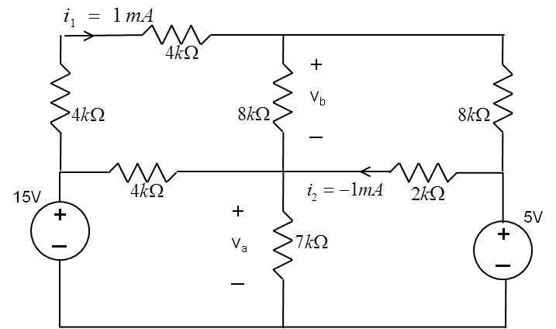
Resistive circuits
Problem 1
Use KVL and Ohms law to compute voltages v_{a} and v_{b} .
-
v₁
From Ohms law:
v₁=8kΩ∗i₁=8[V]
+
v₂=2kΩ∗i₂=-2[V]
Form KVL:
v_{a}=5[V]-v₂=7[V]
v_{b}=15[V]-v₁-v_{a}=0[V]
-
v₂
+
+
+
-
-

Slide 3
Resistive circuits
Problem 2
Write equations to compute voltages v₁ and v₂ , next find the current value of i₁
i₁
From KCL:
50 mA=v₁/40+(v₁-v₂)/40
and
100 mA=v₂/80+(v₂-v₁)/40
i₁
v₁
v₂
50 mA
100 mA
Multiply first equation by 40:
2=v₁+v₁-v₂=2v₁-v₂
From second equation:
8=v₂+2(v₂-v₁)=3v₂-2v₁ add both sides:
10=2v₂ => v₂=5 [V], v₁=1+v₂ /2=3.5[V]
i₁= (v₁-v₂)/40=-1.5/40=37.5 [mA]

Slide 4
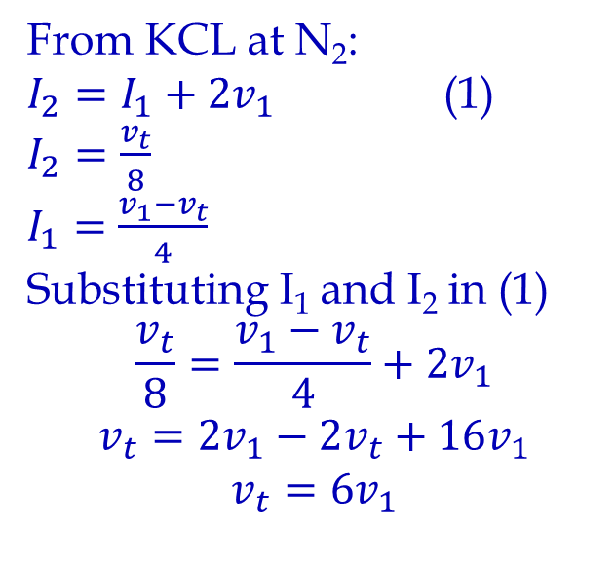
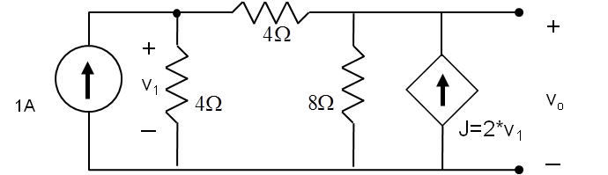
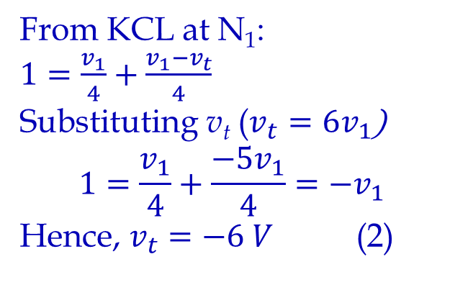
Thevenin & Norton
Problem 3: Find Thevenin and Norton equivalent circuit for the network shown.
N₁
I₁
N₂
I₂
v_{t}
From KVL

Slide 5
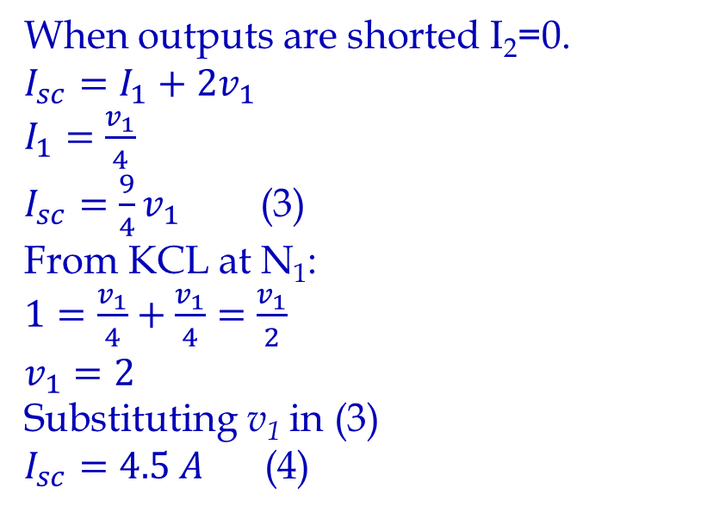
Thevenin & Norton
N₁
I₁
N₂
I₂
I_{sc}
From KVL

Slide 6
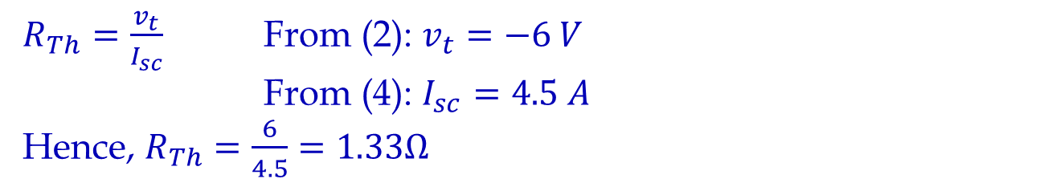
Thevenin & Norton
R_{Th}=v_{t}/I_{sc}=-1.33Ω
Note: Negative v_{t} indicates that the polarity is reversed and as a result this circuit has a negative resistance.
R_{Th}=-1.33Ω
A
A
+
I_{n}=4.5 A
R_{Th}=-1.33Ω
V_{t}=-6 V
_
B
B
Thevenin Equivalent
Norton Equivalent

Slide 7
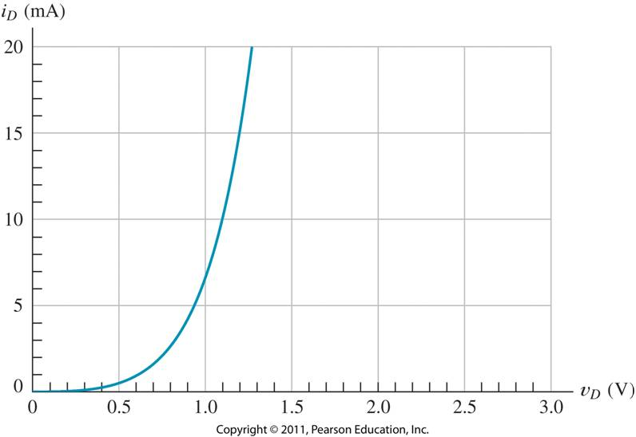
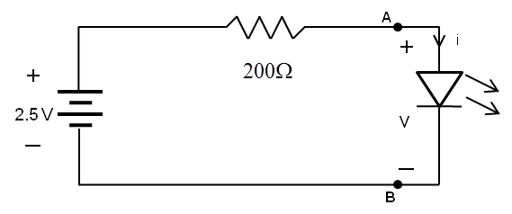
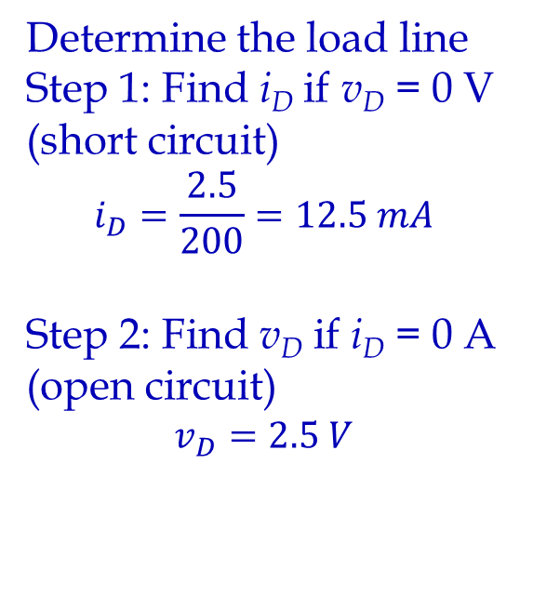
Problem 4: Find the current i and the voltage v across LED diode in the circuit shown on Fig. a) assuming that the diode characteristic is shown on Fig. b).
Draw load line. Intersection of load line and diode characteristic is the i and v across LED diode: v ≈ 1.02 V and i ≈ 7.5 mA.

Slide 8
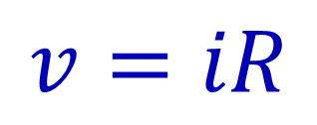
Problem 5: Sketch i versus v to scale for each of the circuits shown below. Assume that the diodes are ideal and allow v to range from -10 V to +10 V.
i
(a)
+
v
_
2kΩ
Diode is on for v > 0 and R=2kΩ.
In a series connection voltages are added for each constant current

Slide 9
Problem 5: Sketch i versus v to scale for each of the circuits shown below. Assume that the diodes are ideal and allow v to range from -10 V to +10 V.
(b)
i
1kΩ
Due to the presence of the 5V supply the diode conducts only for v > 5, R = 1kΩ
+
v
_
+
_
5V
First combine diode and resistance then add the voltage source

Slide 10
Problem 5: Sketch i versus v to scale for each of the circuits shown below. Assume that the diodes are ideal and allow v to range from -10 V to +10 V.
i
(c)
+
v
_
2kΩ
1kΩ
A
B
Diode B is on for v > 0 and R=1kΩ.
Diode A is on for v < 0 and R=2kΩ.

Slide 11
Problem 5: Sketch i versus v to scale for each of the circuits shown below. Assume that the diodes are ideal and allow v to range from -10 V to +10 V.
i
(d)
+
v
_
D
C
1kΩ
Diode D is on for v > 0 and R=1kΩ.
Diode C is on for v < 0 and R=0Ω.

Slide 12
Modeling a piecewise characteristic of a device
Problem 6
Sketch the transfer characteristic (v_{o} versus v_{in}) for the circuit shown in the figure below. Assume that the diode is ideal.
+
v
-
i
i
1kΩ
v_{x}
v
In a parallel connection currents are added for each constant voltage

Slide 13
Modeling a piecewise characteristic of a device
Problem 6
Sketch the transfer characteristic (v_{o} versus v_{in}) for the circuit shown in the figure below. Assume that the diode is ideal.
+
v
-
i
i
1kΩ
v_{x}
v
In a parallel connection currents are added for each constant voltage

Slide 14
Modeling a piecewise characteristic of a device
Problem 6
Add the voltage source.
+
v
-
i
i
+
v_{o}
_
1kΩ
+
V_{in}
-
v
v_{in}
In a series connection voltages are added for each constant current

Slide 15
Modeling a piecewise characteristic of a device
Problem 6
Add the voltage source.
+
v
-
i
i
+
v_{o}
_
1kΩ
+
V_{in}
-
2kΩ
v
v_{in}
In a parallel connection currents are added for each constant voltage

Slide 16
Modeling a piecewise characteristic of a device
Problem 6
Add the voltage source.
+
v
-
i
i
+
v_{o}
_
1kΩ
+
V_{in}
-
2kΩ
v
v_{in}
In a parallel connection currents are added for each constant voltage

Slide 17
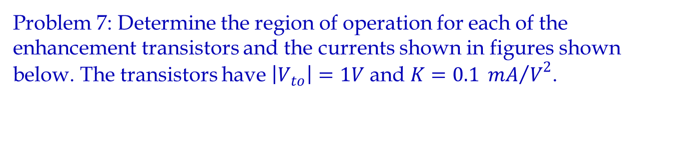
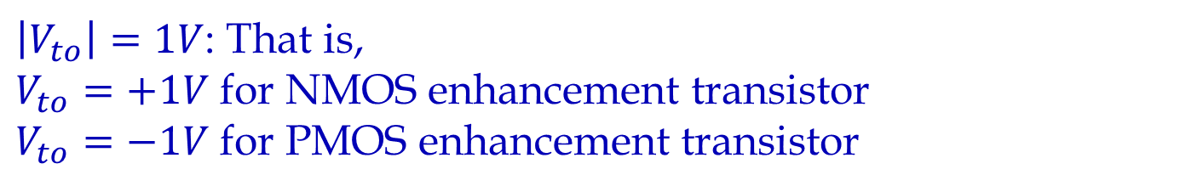
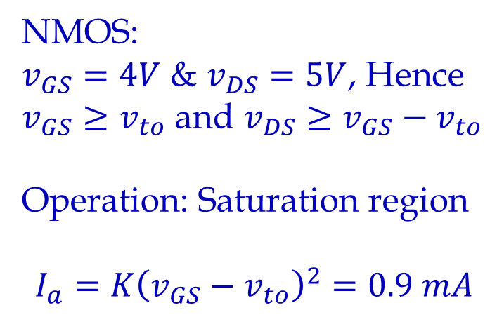
D
(a)
+
G
5V
+
-
4V
I_{a}
-
S

Slide 18
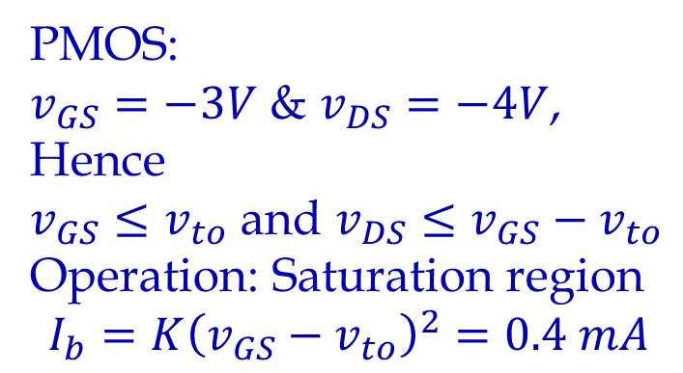
(b)
+
S
3V
I_{b}
-
G
+
1V
-
D

Slide 19
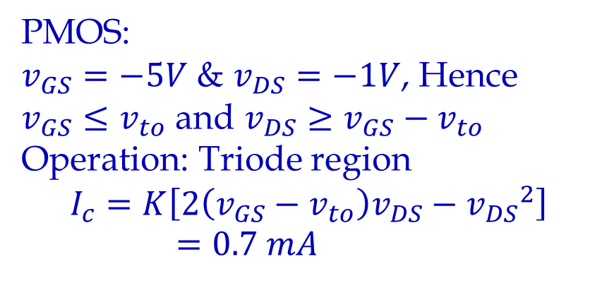
(c)
+
S
5V
I_{c}
G
-
-
4V
c
+
D

Slide 20
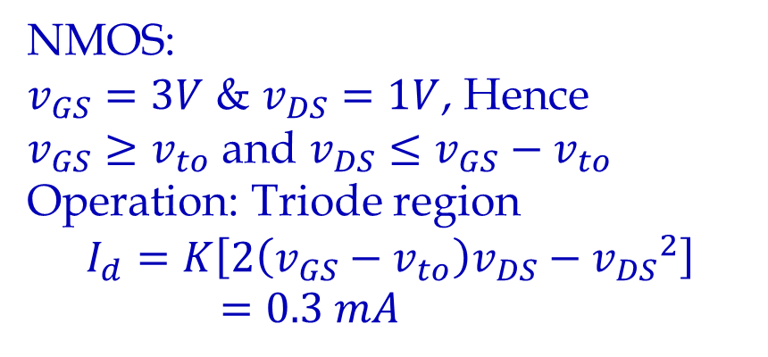
(d)
D
I_{d}
G
+
1V
+
-
3V
-
S

Slide 21
Problem 8: Consider the amplifier shown below.
a) Find v_{GS}(t). Assume that the coupling capacitor is a short circuit for the ac signal and an open circuit for the dc.
Soln (a): In loop 1 the 1.8 MΩ and 200 kΩ resistors act as voltage divider.
The voltage drop across 200 kΩ resistor is the dc voltage V_{GSQ}
V_{GSQ} = 20*0.2/2=2 V
+20 V
1.8 MΩ
2 kΩ
D
Z_{in}
G
Loop 1
S
+
_
sin(200πt)
0.2 MΩ
Treating the capacitor as short for ac signals, we have
V_{GS} =2 + sin(200πt)

Slide 22
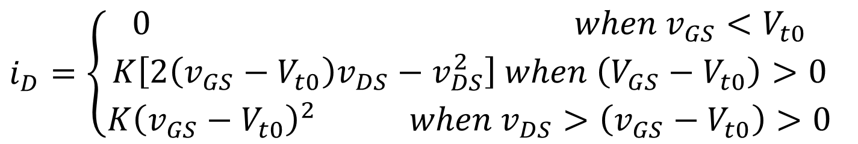
b) If the FET has V_{t0} = 1V and K = 0.5 mA/V², sketch its drain characteristics to scale for V_{GS} = 1, 2, 3, and 4 V.
c) Draw the load line for the amplifier on the characteristics.
d) Find the values of V_{DSQ}, V_{DSmin}, and V_{DSmax}.
To obtain the drain characteristics apply the following equations

Slide 23
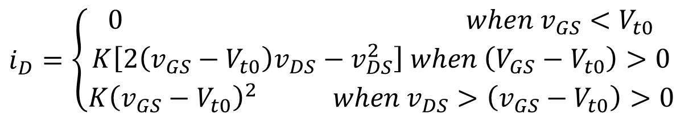
b) Plot shows the drain characteristics for V_{GS} = 1, 2, 3, and 4 V.
c) To get the load line apply KVL to loop 2:
20 – 2 kΩ*i_{D}(t) = V_{DS}(t)
The red line in the plot is the load line.
+20 V
1.8 MΩ
2 kΩ
Z_{in}
D
G
Loop 2
S
+_
sin(200πt)
0.2 MΩ

Slide 24
d) Find the values of V_{DSQ}, V_{DSmin}, and V_{DSmax}.
d) V_{DSQ}, V_{DSmin}, and V_{DSmax} are the points at which the load line intersects the drain characteristics for V_{GS} = 2 V, 3 V and 1 V respectively.
V_{DSQ} = 19 V
V_{DSmin} = 16 V
V_{DSmax} = 20 V

Slide 25
Problem 9: Consider the common source amplifier shown below. Assume NMOS transistor has the following parameters:
𝐾𝑃=60 𝜇𝐴∕𝑉², 𝐿=5 𝜇𝑚, 𝑊=100 𝜇𝑚, 𝑟_{𝑑}=∞, and 𝑉_{𝑡𝑜}=1.5 𝑉. a) Find the values of 𝐼_{𝐷𝑄}, 𝑉_{𝐷𝑆𝑄}and 𝑔_{𝑚}
The 72 kΩ and 28 kΩ resistors act as a voltage divider. The voltage drop across 28 kΩ resistor is the dc voltage V_{GSQ} is equal to
+10 V
R₁ =
72 kΩ
R_{D} = 5 kΩ
C₁
C₂
+
v_{o}
_
+
v_{in}
_
R₂ =
28 kΩ
R_{L}=
1 kΩ

Slide 26
Problem 9 b): - Assuming that the coupling capacitors are short circuits for the ac signal, determine the following: voltage gain, input resistance and output resistance.
+10 V
R₁ =
72 kΩ
R_{D} = 5 kΩ
C₁
C₂
+
v_{o}
_
+
v_{in}
_
R₂ =
28 kΩ
R_{L}=
1 kΩ

Slide 27
Problem 10: - Consider the common source amplifier shown below. Assume NMOS transistor has the following parameters:
𝐾𝑃=75 𝜇𝐴∕𝑉² , 𝐿=10 𝜇𝑚, 𝑊=400 𝜇𝑚, 𝑟_{𝑑}=∞, and 𝑉_{𝑡𝑜}=1 𝑉. a) If R_{in} = 250 kΩ, find the values for R₁ and R₂ to achieve 𝐼_{𝐷𝑄}=2 𝑚𝐴.
+15 V
R_{in}
R₁
R_{D} =
2 kΩ
C₁
R
C₂
+
v_{in}(t)
_
v(t)
+
_
R₂
+
v_{o}
_
R_{S} =
0.5 kΩ
R_{L} =
5 kΩ

Slide 28
+15 V
R_{in}
R₁
R_{D} =
2 kΩ
C₁
R
C₂
+
v_{in}(t)
_
v(t)
+
_
R₂
+
v_{o}
_
R_{S} =
0.5 kΩ
R_{L} =
5 kΩ
We have:
Given:
Solve for R₁:

Slide 29
We have R_{in} = 250 kΩ and R₁ = 1.19 M Ω
Solve for R₂:
b) Determine the voltage gain

Slide 30
Problem BJT P1: It has been found that in the circuit below V_{E} = 1V.
If V_{BE} = -0.6V, determine: V_{B}, I_{B}, I_{E}, I_{C}, β, and α.
Soln (a): From KVL:
From KVL:
Ohm’s law:
I_{E}
V_{E} = 1V
V_{BE} = -0.6V
V_{B}
I_{B}
I_{C}

Slide 31
Problem BJT P2: - For the circuit below assume both transistors are silicon-based with β = 100. Determine: a) I_{C1}, V_{C1}, V_{CE1}. b) I_{C2}, V_{C2}, V_{CE2}.
Soln:
Assume V_{BE}= V_{BE1} =V_{BE2} = 0.7V
Part (a): - Apply KVL along the path (red line).
R_{B1}
R_{C1}
I_{C2}
R_{C2}
I_{B1}
I_{C1} + I_{B2}
I_{B2}
V_{C1}
I_{C1}
V_{CE2}
V_{BE2}
V_{CE1}
V_{BE1}
I_{E2}
R_{E2}

Slide 32
Part (a) contd.: - Apply KVL along the path (red line).
We know that
substituting we get
R_{B1}
R_{C1}
I_{C2}
R_{C2}
I_{B1}
I_{C1} + I_{B2}
I_{B2}
V_{C1}
I_{C1}
V_{CE2}
V_{BE2}
V_{CE1}
V_{BE1}
I_{E2}
R_{E2}

Slide 33
Part (b): - Apply KVL along the path (red line).
R_{B1}
R_{C1}
I_{C2}
R_{C2}
I_{B1}
I_{C1} + I_{B2}
I_{B2}
V_{C2}
V_{C1}
I_{C1}
V_{CE2}
V_{BE2}
V_{E2}
V_{CE1}
V_{BE1}
I_{E2}
R_{E2}

Slide 34
Problem BJT P3: - Design the bias circuit (find R_{C} and R_{B}) to give a Q-point of I_{C} = 20µA and V_{CE} = 0.9V if the transistor current gain β_{F} = 50 and V_{BE} = 0.65V.
What is the Q-point if the current gain of the transistor is 125?
Soln: Apply KVL along the path (red line).
I_{B}
I_{C} = 20µA
V_{CE} = 0.9V
V_{BE} = 0.65V

Slide 35
Soln contd.: (find R_{C} and R_{B}) to give a Q-point of I_{C} = 20µA and V_{CE} = 0.9V.
Apply KVL along the path (red line).
I_{B}
I_{C} = 20µA
V_{CE} = 0.9V
V_{BE} = 0.65V

Slide 36
Soln contd.: Find the Q-point if the current gain, β_{F} = 125. We have R_{C}=29.41kΩ, and R_{B}=625kΩ, from previous calculations.
Apply KVL along the path (red line).
I_{C} + I_{B}
I_{B}
I_{C}
V_{CE}
V_{BE} = 0.65V

Slide 37
Soln contd.: Apply KVL along the path (red line).
The Q-Point is:
I_{C} + I_{B}
I_{B}
I_{C}
V_{CE}
V_{BE} = 0.65V

Slide 38
Problem OP-AMP P1: - Consider the op-amp circuit shown below. If 𝑣_{𝑖𝑛} (𝑡) = 6 + 9𝑐𝑜𝑠(500𝜋𝑡), calculate the value of R₂ required to generate a output, v_{o}(t), with zero DC component. What is the resulting output voltage?
R₂
Soln: The circuit shown is that of a differential amplifier. We can use superposition theorem to solve for the output voltage: connect inputs to ground (0 V), one at a time, and solve for output voltage.
5 kΩ
V_{a}
-
+
+
v_{in}(t)
_
i_{in}
V_{b}
+
v_{o}(t)
_
+
5V
_
KVL2
KVL1
From summing point constraints: V_{a} = V_{b}
From KVL2
From KVL1 and Ohms law
Therefore

Slide 39
R₂
5 kΩ
V_{a}
-
+
+
v_{in}(t)
_
V_{b}
+
v_{o}(t)
_
If DC component of v_{o} is zero,
Multiplying by 5kΩ on both sides and solving for R₂,
R₂ = 25 kΩ
Then the output is 𝑣_{o} = - 45𝑐𝑜𝑠(500𝜋𝑡),
+
5V
_

Slide 40
Problem OP-AMP P2: - Consider the op-amp circuit shown below. Assume the maximum output voltage of the op-amp ranges from – 12 V to + 12 V; the maximum output current magnitude is 25 mA; and the slew-rate limit is 1.5 V/µs. If 𝑣_{𝑖𝑛} (𝑡)=𝑣_{𝑚}𝑠𝑖𝑛(𝜔𝑡), R₁ = 5 kΩ, and R₂ = 25 kΩ. a) Find the full-power bandwidth of the op-amp.
Soln: The full-power bandwidth of the op-amp is given by
Slew-rate, SR = 1.5 V/µs;
maximum output amplitude,V_{om} = 12 V.
R₂
R₁
-
+
+
v_{in}(t)
_
+
v_{o}(t)
_
R_{L}

Slide 41
b) Find the peak output voltage possible without distortion for the following cases:
Case a: Frequency of 5 kHz and R_{L} = 20 Ω
  Soln.: The current limit of the op-amp limits the peak output voltage. Since R_{L} is very small compared to R₂ the current through R₂ can be neglected. Thus the peak output voltage is given by
Case b: Frequency of 5 kHz and R_{L} = 2.5 kΩ
  Soln.: V_{om} = 12 V (The maximum voltage that the op-amp can achieve.)
Case c: Frequency of 50 kHz and R_{L} = 2.5 kΩ
  Soln.: The slew-rate limit of the op-amp limits the peak output voltage.

Slide 42
Problem Logic Gates P1: - Express the following functions in canonical SOP form. (Hint: Draw the truth table for each one first.).
Soln:-
a) F(A, B, C) = (A + B’)C’ + A’C
F(A, B, C) = AC’ + B’C’ + A’C=
A’B’C’+A’B’C+A’BC+AB’C’+ABC’
b) F(X, Y, Z) = (X + Y’)(X’ + Z) + ZY’
F(X, Y, Z) = XX’ + XZ + X’Y’ + Y’Z + ZY’
F(X, Y, Z) = XZ + X’Y’ + Y’Z
= =X’Y’Z’+X’Y’Z+XY’Z+XYZ
A | B | C | F
0 | 0 | 0 | 1
0 | 0 | 1 | 1
0 | 1 | 0 | 0
0 | 1 | 1 | 1
1 | 0 | 0 | 1
1 | 0 | 1 | 0
1 | 1 | 0 | 1
1 | 1 | 1 | 0
X | Y | Z | F
0 | 0 | 0 | 1
0 | 0 | 1 | 1
0 | 1 | 0 | 0
0 | 1 | 1 | 0
1 | 0 | 0 | 0
1 | 0 | 1 | 1
1 | 1 | 0 | 0
1 | 1 | 1 | 1

Slide 43
c) F(A, B, C, D) = AB’C + A’BC’D + A’BCD’ + B’D’
F(A, B, C, D) =AB’CD+AB’CD’+ A’BC’D + A’BCD’ + +AB’C’D’+A’B’CD’+A’B’C’D’
d) F(W, X, Y, Z) = WX’ + Z’(Y’ + W’) + W’Z’Y’
F(W, X, Y, Z) = WX’ + Y’Z’ + W’Z’ + W’Z’Y’
F(W, X, Y, Z) = W’X’YZ’+W’X’YZ’+WX’YZ’+WX’Y’Z’+
+WX’YZ+WX’Y’Z+WXY’Z’+W’XY’Z’+W’XYZ’
Karnaugh Map instead of truth table:
 |  |  | C
 |  |  |  | D
 |  | 1 | 1
A |  | 1 | 1 | 1
 | B
 |  |  | 1 |  | 1
 |  |  | Y
 |  |  |  | Z
 |  | 1 | 1
W |  | 1 | 1 | 1 | 1
 | X | 1
 |  | 1 | 1

Slide 44


Problem Logic Gates P2: - Realize AND, OR and NOT functions using: a) NOR, b) NAND
Soln. a:- Using NOR Gates
Soln. b:- Using NAND Gates

Slide 45
Problem Logic Gates P3: - a) Use Karnaugh-map to find the SOP form of the following function:
F = BC’D’ + BC’D + A’C’D’ + BCD’ + A’B’CD’
Soln:-
F = BC’D’ + BC’D + A’C’D’ + BCD’ + A’B’CD’
SOP: F = BD’ + BC’ + A’D’
 |  | C
 | 1 | 1
A
 | 1 | 1 |  | 1 | B
 | 1 | 1 |  | 1
 |  |  | D

Slide 46
Problem Logic Gates P3: - b) Find the minimum POS form of the function above and draw a logic circuit representing the same.
Soln:-
For minimum POS – Minimize the logic function F’ and take inverse. That is consider locations with zero (0) and then invert the result.
POS: F = (B + D’) . (A’ + B) . (C’ + D’)
 |  | C
 | 1 | 1 | 0 | 0
A | 0 | 0 | 0 | 0
 | 1 | 1 | 0 | 1 | B
 | 1 | 1 | 0 | 1
 |  |  | D

